Slide 1


Phishing URL Detection Project: A Machine Learning Approach
Safeguarding Online Interactions through Predictive Analytics
Presenter: MUKESH MAGAR
by mukesh magar

Slide 2
Agenda Overview
Project Workflow
Key Insights & Results
Business Impact
From Problem to Solution
What We Found
Why This Matters
Challenges & Learnings
Q&A and Support
Our Journey
Materials and Discussion

Slide 3
Problem Definition: The Phishing Threat
What is Phishing?
Impact
Our Goal
Deceptive info stealing via fake emails or sites
Financial fraud and identity theft
Build accurate ML model to classify URLs
Data breaches and reputational damage
Targets credentials, credit cards, sensitive info
Automate detection for proactive protection
Growing cybersecurity challenge

Slide 4







Project Workflow: Machine Learning Journey
Problem Definition
Data Collection
Preprocessing
Model Training
Evaluation
Deployment
Monitoring & Retraining

Slide 5
Data Preprocessing: Preparing Our Data
Initial Data Loading
Feature Engineering
Train-Test Split
Dataset with URL features and labels
Multicollinearity analysis with VIF
Ensured unbiased model evaluation
Dimensionality reduction using PCA
Inspected data structure and types

Slide 6

Model Training: Random Forest Classifier
Algorithm Choice
Training Process
Benefits
Ensemble method combining multiple decision trees
Model learns URL patterns and feature relations
High accuracy and control overfitting

Slide 7
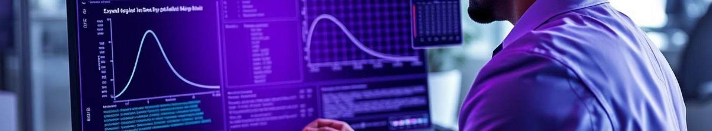
Model Evaluation: Performance Metrics
10-Fold Cross Validation
Accuracy Metric
Additional Visualizations
Robust generalization assessment
Proportion of correctly classified URLs
Confusion Matrix
ROC Curve

Slide 8
Deployment & Future Directions
Conceptual Deployment
Real-Time Applications
Continuous Improvement
Integrate model into APIs and services
Browser extensions
Monitoring and retraining with new data
Email filters
Network security tools

Slide 9
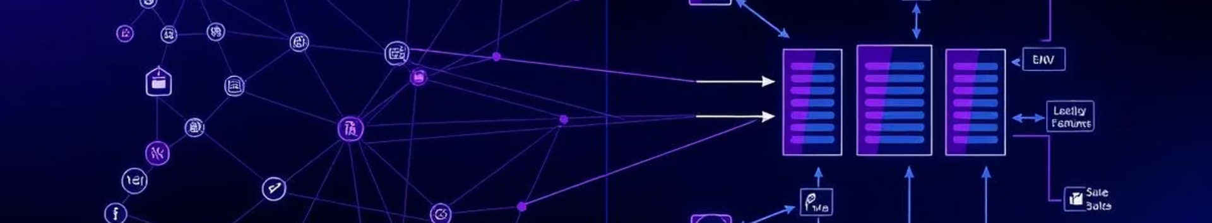
Key Insights: Understanding Our Data
URL Feature Types
Data Challenges
Feature Importance
Lexical (length, special characters)
Class imbalance requiring preprocessing care
Random Forest highlights predictive URL traits
Host-based (IP usage, domain age)
Content-based (HTTPS, keywords presence)

Slide 10
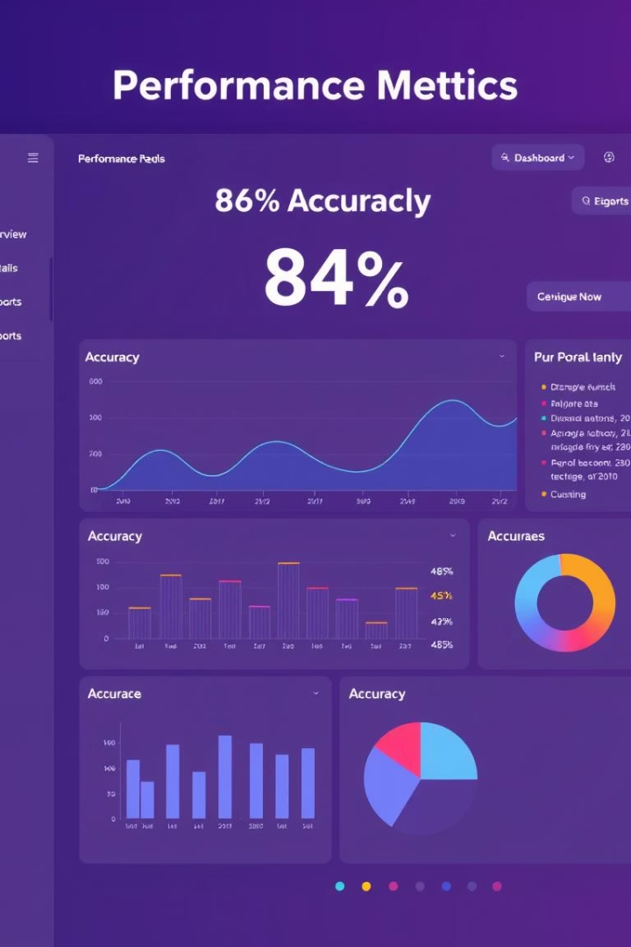
Key Results: Robust Model Performance
84.51%
83.49%-85.99%
Average Accuracy
Fold Accuracy Range
Across 10-fold cross validation
Consistent high performance
—
Implication
Strong generalization for phishing detection

Slide 11

Business Impact: Safeguarding the Digital Landscape
Enhanced Security
Proactive phishing detection reduces malicious links exposure
Risk Mitigation
Prevents financial loss, data breaches, and reputational harm
Improved User Trust
Creates safer digital environments, boosting user confidence
Operational Efficiency
Automated detection lowers manual threat analysis efforts

Slide 12
Challenges Faced: Navigating the Project
Data Quality & Availability
Feature Engineering Complexity
Evolving Threat Landscape
Model Interpretability
Explaining Random Forest predictions is challenging
Diverse, updated, balanced phishing datasets needed
Extracting meaningful URL features requires expertise
Phishing techniques continuously adapt
Models must be robust and adaptive
Interpretability crucial for trust and tuning
Data must reflect evolving phishing tactics
Iterative refinement key to discriminative features

Slide 13
Key Learnings: Growth Through Experience
Data Preprocessing
Ensemble Methods
Cross-Validation
Essential for model accuracy and reliability
Random Forest excels for robust binary classification
Ensures unbiased performance estimation
Iterative Development
Cybersecurity Awareness
Continuous refinement drives project success
Highlights need for automated security solutions

Slide 14





Conclusion & Future Directions
Project Success
Accurate machine learning model for phishing detection
Advanced Models
Explore deep learning techniques for better accuracy
Real-Time Learning
Integrate streaming data for continuous updates
User Interface
Develop accessible platform for public testing
Feature Expansion
Include webpage content and image analysis

Slide 15

THANK YOU

